Slide 1

Beer in USA
- Analysis by Javi and Shan

Slide 2
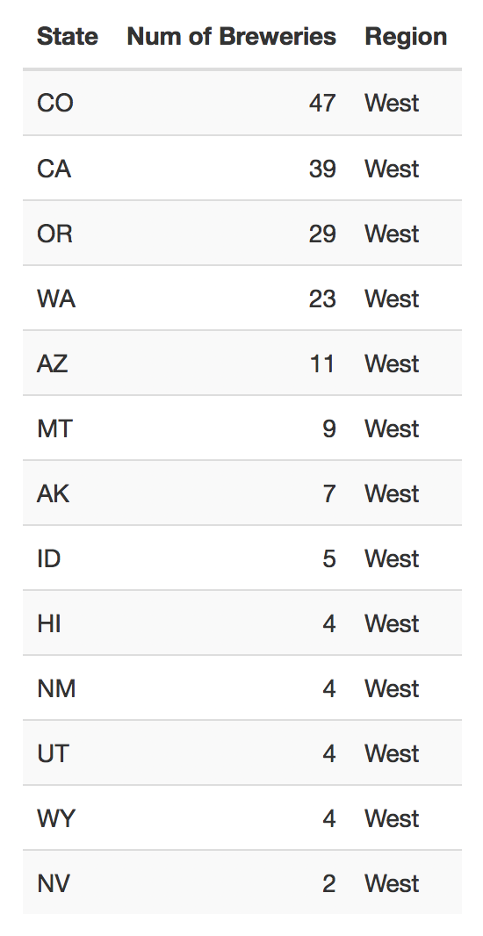
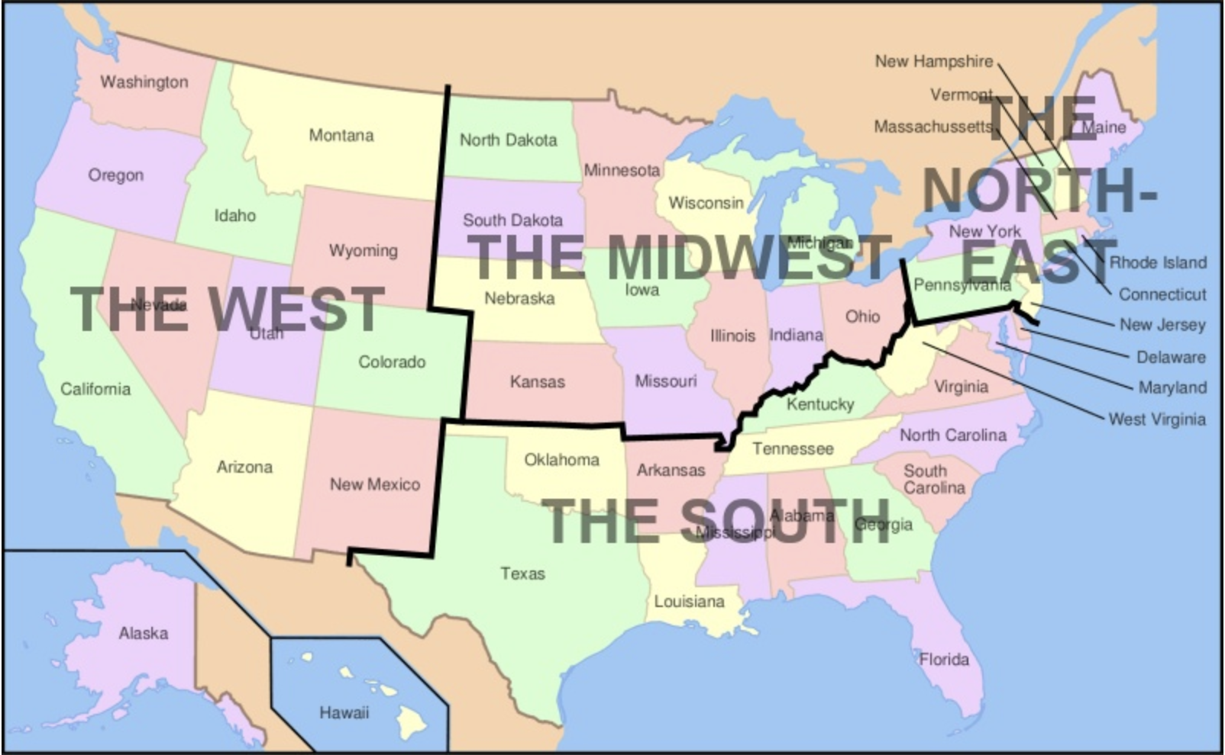
Breweries in the West

Slide 3
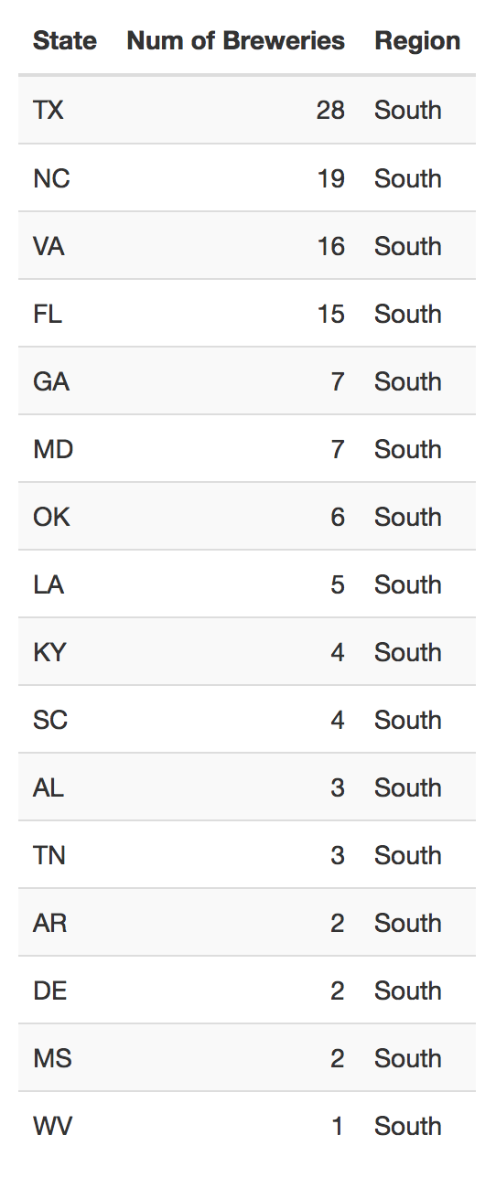
Breweries in the South

Slide 4
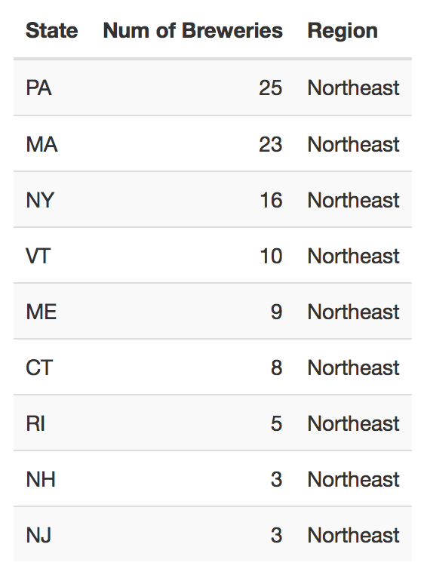
Breweries in the Northeast

Slide 5
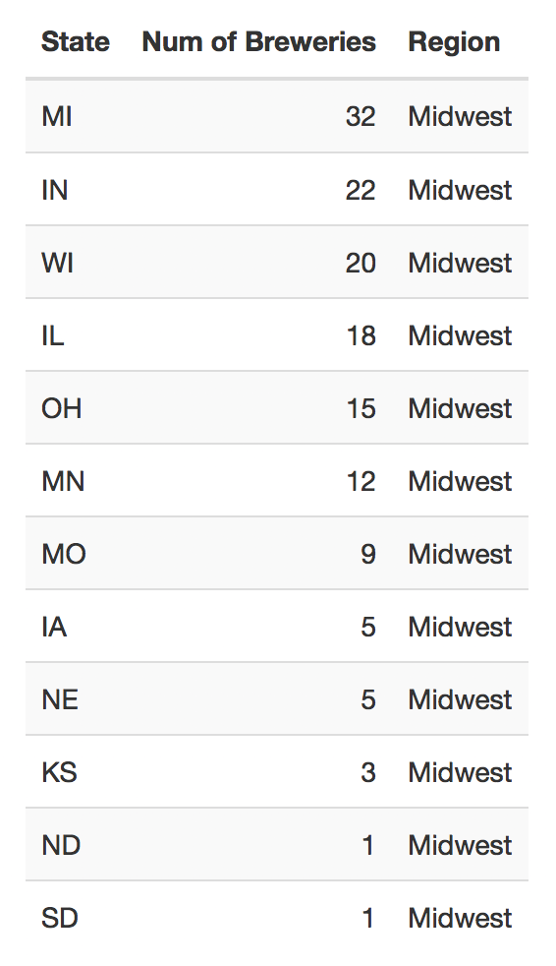
Breweries in the Midwest

Slide 6
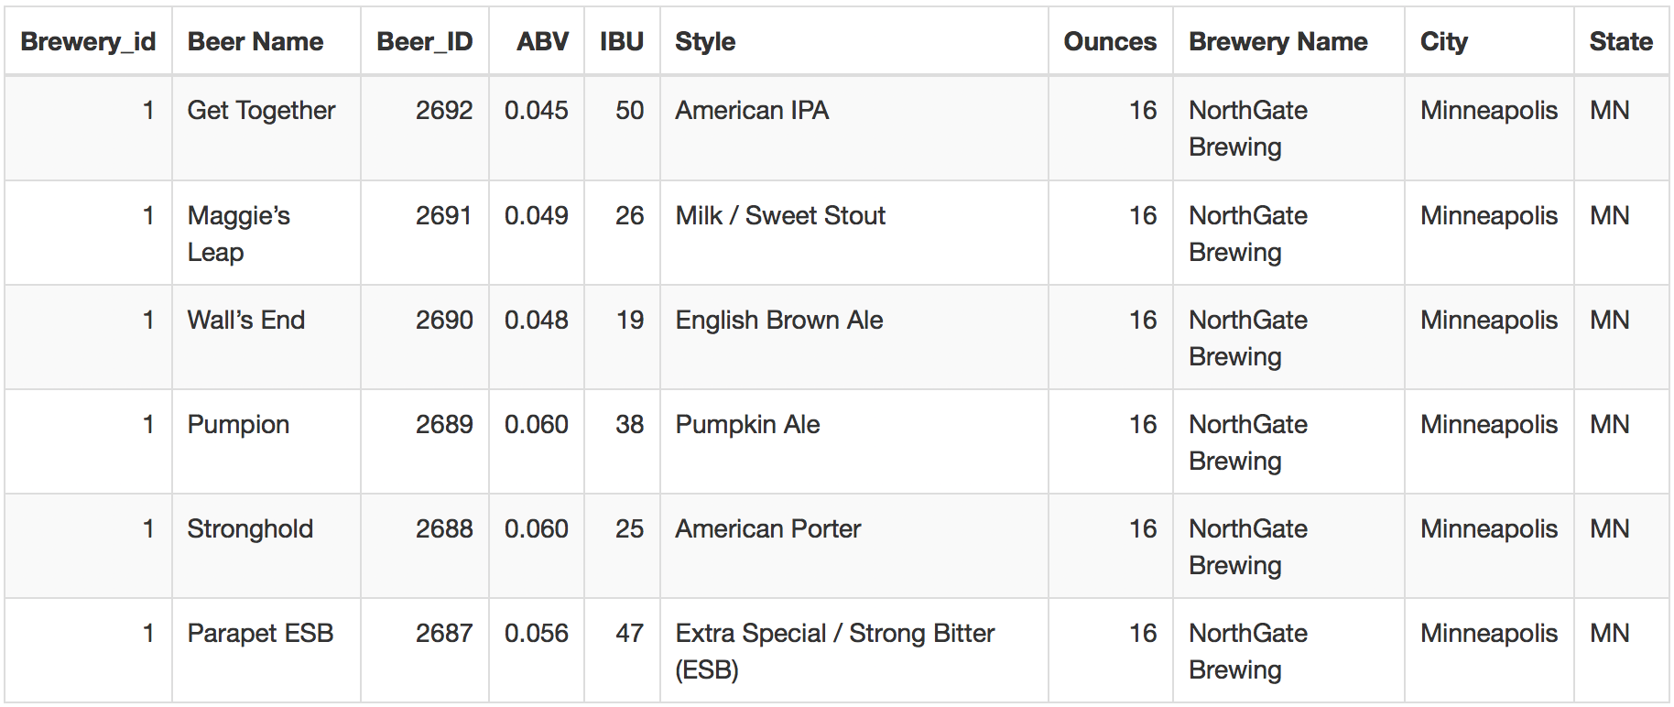
Beer and Brewery Data: (Head)

Slide 7
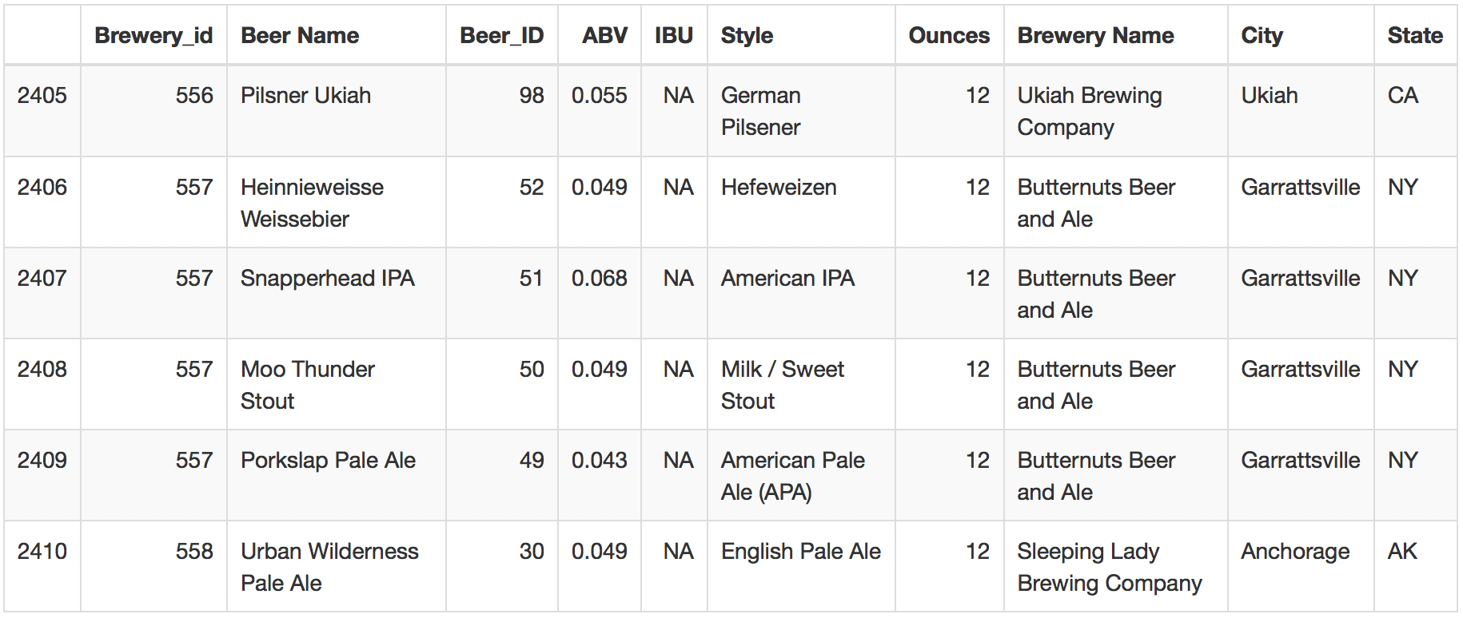
Beer and Brewery Data: (Tail)

Slide 8
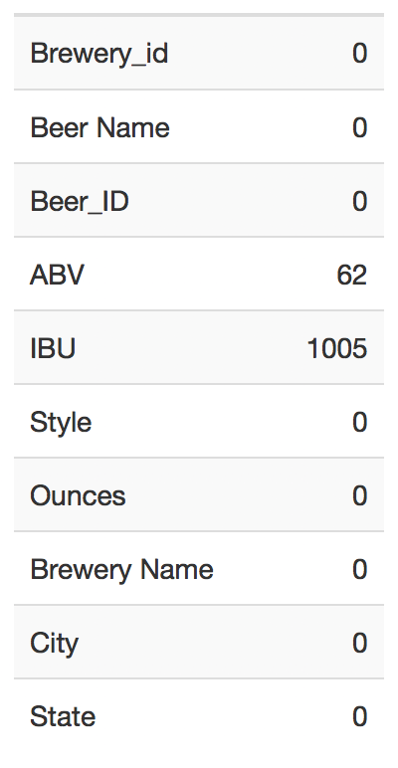
Count of the Missing Values in the table

Slide 9
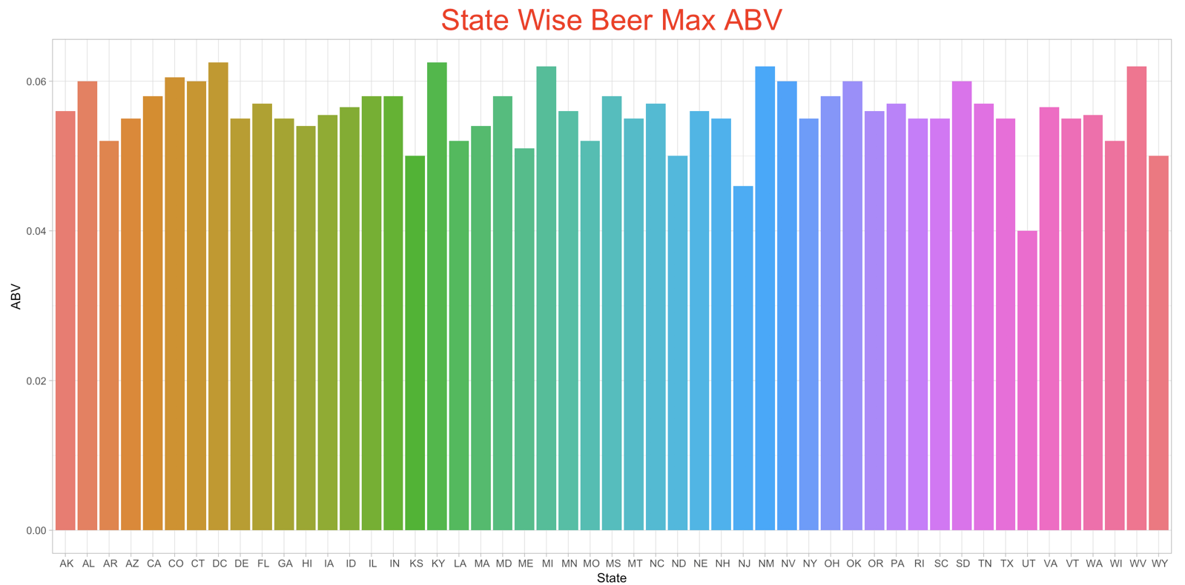
Max Alcohol Beer Content

Slide 10
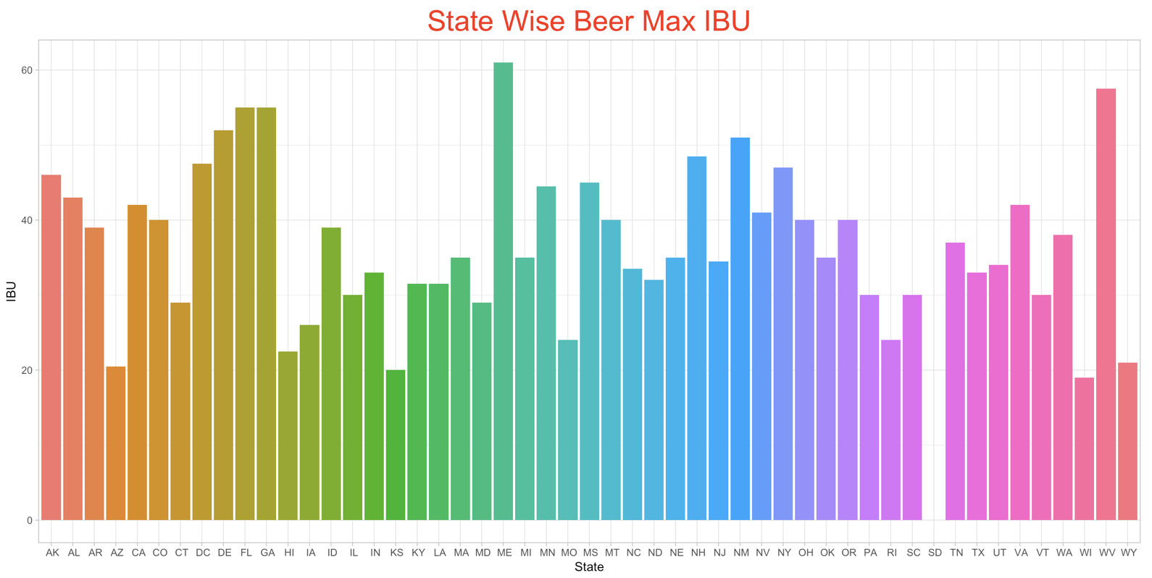
Max Beer Bitterness

Slide 11
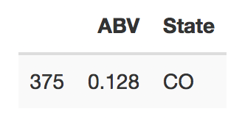
State with Max Beer Alcohol Content!!!

Slide 12
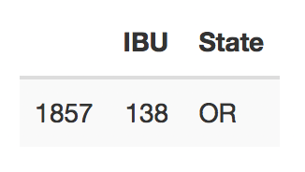
State that has most bitter Beer!!!

Slide 13
Statistical Summary of the Beer Alcohol Content:

Slide 14
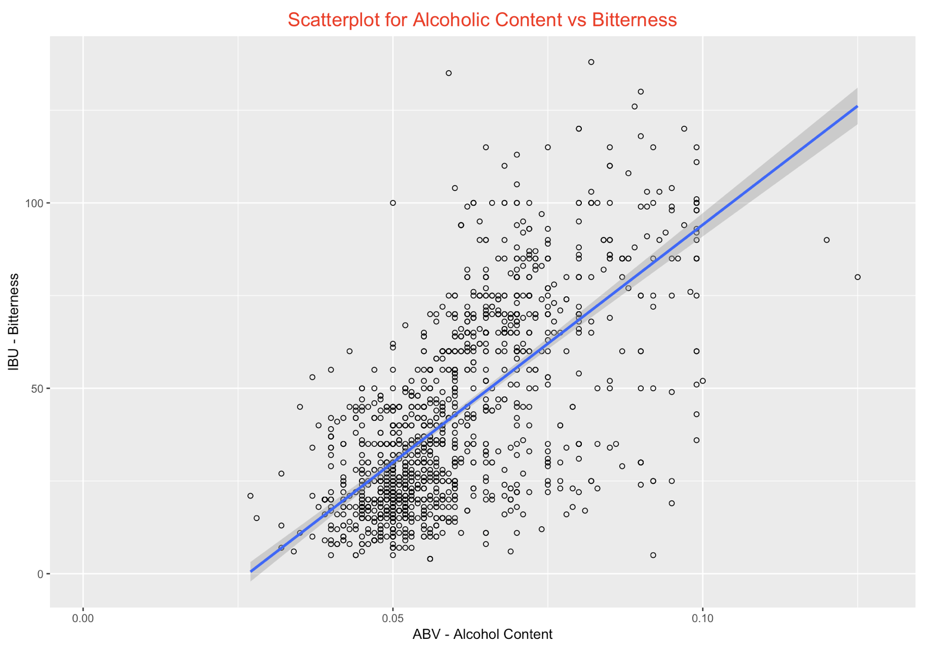
Relationship Between Alcohol Content and Bitterness

Slide 15
CEO / CFO Conclusion

